Slide 1
Maker’s university – by intel’s makers community Advanced topics
Gil Tal.
Feb 2025

Slide 3
ESP32 is running Free-RTOS!
FreeRTOS is a lightweight, open-source real-time operating system (RTOS) designed for embedded systems.
Provides task scheduling, inter-task communication, and resource management, enabling efficient multitasking on microcontrollers like the ESP32-S3. FreeRTOS uses a preemptive or cooperative scheduler, ensuring tasks execute with precise timing. It supports mutexes, semaphores, queues, and timers.

Slide 4
Multi Tasking – Dual CPU
void setup() {
Serial.begin(115200);
// Create Task 1
xTaskCreatePinnedToCore(
Task1, // Function name
"Task 1", // Task name
2048, // Stack size (in bytes)
NULL, // Parameters
5, // Priority (higher = more priority)
&Task1Handle, // Task handle
1 // Pin task to CPU 1
);
// Create Task 2
xTaskCreatePinnedToCore(
Task2, // Function name
"Task 2", // Task name
2048, // Stack size
NULL, // Parameters
5, // Priority
&Task2Handle, // Task handle
0 // Pin task to CPU 0
);
}
void loop() {
// Empty, since FreeRTOS handles the tasks
}
TaskHandle_t Task1Handle = NULL;
TaskHandle_t Task2Handle = NULL;
// Task 1 function
void Task1(void* pvParameters) {
while (1) {
printf("Task 1 Running on CPU 1\n");
vTaskDelay(pdMS_TO_TICKS(1000)); // Delay 1000ms (1 second)
}
}
// Task 2 function
void Task2(void* pvParameters) {
while (1) {
printf("Task 2 Running on CPU 0\n");
vTaskDelay(pdMS_TO_TICKS(500)); // Delay 500ms
}
}

Slide 5
Queue
// Queue handle
QueueHandle_t myQueue;
// Sender Task
void SenderTask(void* pvParameters) {
int count = 0;
while (1) {
count++; // Increment counter
if (xQueueSend(myQueue, &count, portMAX_DELAY) == pdPASS) {
Serial.print("Sent: ");
Serial.println(count);
}
vTaskDelay(pdMS_TO_TICKS(1000)); // Delay 1 second
}
}
// Receiver Task
void ReceiverTask(void* pvParameters) {
int receivedValue;
while (1) {
if (xQueueReceive(myQueue, &receivedValue, portMAX_DELAY) == pdTRUE) {
Serial.print("Received: ");
Serial.println(receivedValue);
}
}
}
void setup() {
Serial.begin(115200);
// Create queue with space for 5 integers
myQueue = xQueueCreate(5, sizeof(int));
if (myQueue == NULL) {
Serial.println("Queue creation failed!");
return;
}
// Create sender task
xTaskCreate(SenderTask, "Sender Task", 2048, NULL, 1, NULL, 0);
// Create receiver task
xTaskCreate(ReceiverTask, "Receiver Task", 2048, NULL, 1, NULL, 1);
}
void loop() {
// Nothing here, tasks handle execution
}

Slide 6
Semaphore
SemaphoreHandle_t mySemaphore;
// Task 1 - Tries to access the shared resource
void Task1(void* pvParameters) {
while (1) {
if (xSemaphoreTake(mySemaphore, portMAX_DELAY)) { // Take semaphore
printf("Task 1 is using the resource...\n");
vTaskDelay(pdMS_TO_TICKS(1000)); // Simulate work
printf("Task 1 done.\n");
xSemaphoreGive(mySemaphore); // Release semaphore
}
vTaskDelay(pdMS_TO_TICKS(500)); // Wait before retrying
}
}
// Task 2 - Also tries to access the shared resource
void Task2(void* pvParameters) {
while (1) {
if (xSemaphoreTake(mySemaphore, portMAX_DELAY)) { // Take semaphore
printf("Task 2 is using the resource...\n");
vTaskDelay(pdMS_TO_TICKS(1000)); // Simulate work
printf("Task 2 done.\n");
xSemaphoreGive(mySemaphore); // Release semaphore
}
vTaskDelay(pdMS_TO_TICKS(500)); // Wait before retrying
}
}
void setup() {
Serial.begin(115200);
// Create binary semaphore
mySemaphore = xSemaphoreCreateBinary();
xSemaphoreGive(mySemaphore); // Give initial access
// Create tasks
xTaskCreate(Task1, "Task 1", 2048, NULL, 1, NULL);
xTaskCreate(Task2, "Task 2", 2048, NULL, 1, NULL);
}
void loop() {
// Empty, tasks run in FreeRTOS
}

Slide 7
Interrupts
// Timer handle
hw_timer_t* myTimer = NULL;
// Interrupt flag
volatile bool toggleFlag = false;
unsigned int counter = 0;
// Timer Interrupt Service Routine (ISR) on CPU0
void IRAM_ATTR onTimer() {
counter++;
}
void setup() {
Serial.begin(115200);
// Initialize Timer (Timer 0, Divider = 80 → 1 tick = 1 µs)
myTimer = timerBegin(0, 80, true);
// Attach Interrupt (ISR triggers every 1000 µs = 1 ms)
timerAttachInterrupt(myTimer, &onTimer, true);
timerAlarmWrite(myTimer, 1000, true);
timerAlarmEnable(myTimer); // Start Timer
}
void loop()
{
printf("Counter = %d\n", counter);
delay(1000);
}

Slide 8
Interrupts linked to core 0
void setup() {
Serial.begin(115200);
pinMode(10, OUTPUT); // Set GPIO10 as output
// Create task pinned to CPU0
xTaskCreatePinnedToCore(
[](void* pvParameters) {
setupTimerOnCPU0();
vTaskDelete(NULL); // Self-delete after setting up timer
},
"TimerSetupTask", // Task name
2048, // Stack size
NULL, // Task parameters
1, // Priority
NULL, // Task handle
0 // Run on CPU0
);
}
void loop()
{
printf("Counter = %d\n", counter);
delay(1000);
}
// Timer handle
hw_timer_t* myTimer = NULL;
// Interrupt flag
volatile bool toggleFlag = false;
unsigned int counter = 0;
// Timer Interrupt Service Routine (ISR) on CPU0
void IRAM_ATTR onTimer() {
counter++;
}
// Function to configure the timer and link ISR to CPU0
void setupTimerOnCPU0() {
// Initialize Timer (Timer 0, Divider = 80 → 1 tick = 1µs)
myTimer = timerBegin(0, 80, true);
// Set alarm to trigger ISR every 1000 µs (1 ms)
timerAttachInterrupt(myTimer, &onTimer, true);
timerAlarmWrite(myTimer, 1000, true);
timerAlarmEnable(myTimer);
}

Slide 9
Memory handling and allocation
ESP32-S3 has 384KB of tightly coupled SRAM – Fasted and cacheable
Allocation via malloc and new
ESP32-S3 can be equipped with external RAM (PSRAM) connected via SPI 4 or 8 bit wide, from 2MB up to 8MB, is it slower (80 MHz bus speed) but cacheable
Allocation via ps_malloc
ESP32 has the option to combine the two memory into one heap using:
heap_caps_malloc_extmem_enable(1024 * 1024 * 2 /* chunk size from SRAM*/);

Slide 10

Hazards!
Tasks and interrupts service routines have watchdogs!!
When expired ESP will reboot!
Calling delay(time) or vTaskDelay(ms) resets the WDT in a task
Interrupts cannot be protected, they must be short in code
If task needs more time we need to reset the WDT:
Within the task:
esp_task_wdt_add(taskHandle); // Only Once
esp_task_wdt_reset();
We cannot print from an interrupt service routine!
We cannot call an interrupt driven driver call from an interrupt service routine! Like I2Cread for example.

Slide 11
More Hazards!
If a CPU needs to burn the flash memory (EEPROM update, or load image into flash from SD card), no interrupts should run on the specific CPU!
WiFi and Bluetooth stack runs on Core 0 and they are interrupt driven

Slide 12
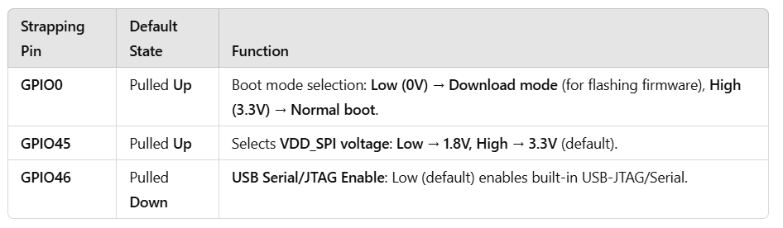
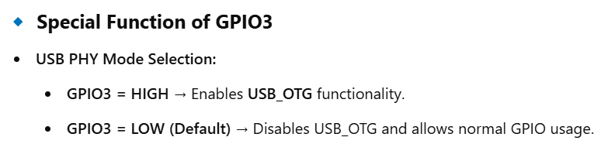
GPIO restrictions for the ESP32-S3
GPIO 19 and 20 are being used for the OTG USB port
Strapping pin: GPIO0, GPIO3, GPIO45 and GPIO46 are strapping pins.
SPI0/1: GPIO26-32 are usually used for SPI flash and PSRAM and not recommended for other uses. When using Octal Flash or Octal PSRAM or both, GPIO33~37 are connected to SPIIO4 ~ SPIIO7 and SPIDQS.

Slide 13
Let's see it working in practice within the Game- Boy emulator

Slide 14
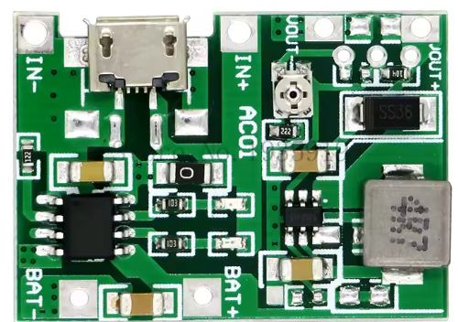


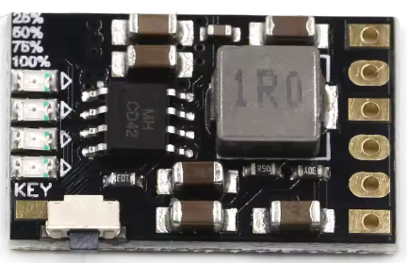
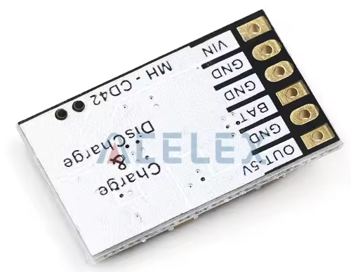

Battery power handling:
Most attractive battery is 18650 , 3.7V and around 3000 mAh of capacity
Can be connected in parallel!!
Capable of running RPI4 with Batocera emulator!

Slide 15


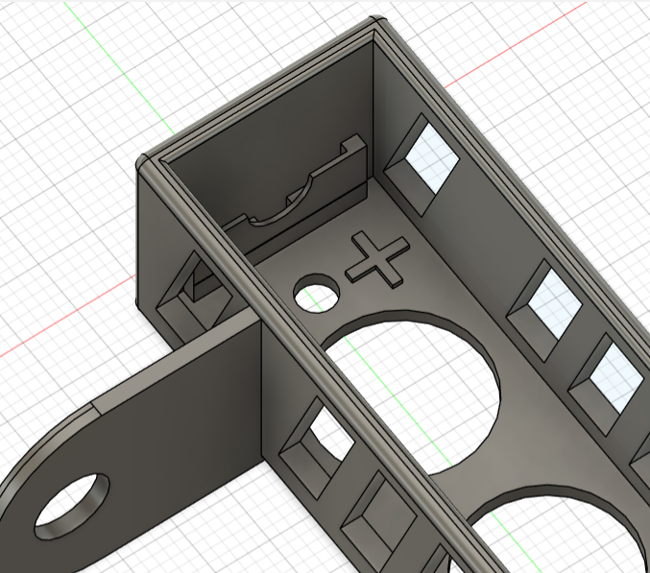
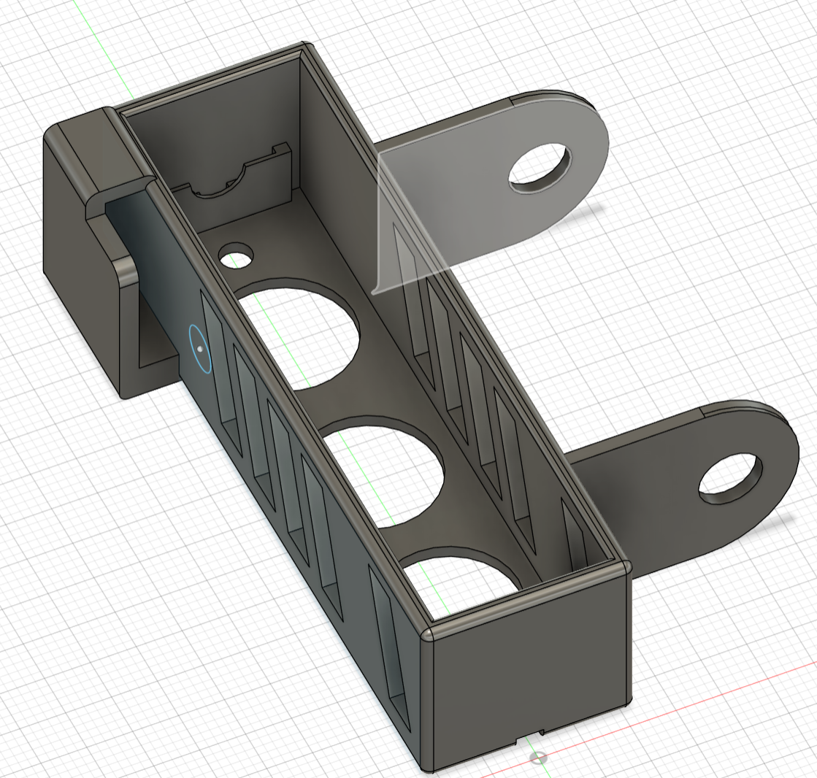
https://www.aliexpress.com/item/1005003632558639.html?spm=a2g0o.order_list.order_list_main.246.5aa71802tCtthv

